Slide 1
Design and Analysis of Algorithms Asymptotic Notations
Week 4 and 5
By
Dr Rafiullah Khan
Senior Lecturer ICS/IT
The University of Agriculture Peshawar, Pakistan
For resources, please visit: https://rafiyz.github.io/courses/Algorithms/algo.htm

Slide 2
Rabbit Problem
Suppose a newly-born pair of rabbits, one male, one female, are put in a field. Rabbits are able to mate at the age of one month so that at the end of its second month a female can produce another pair of rabbits. Suppose that our rabbits never die and that the female always produces one new pair (one male, one female) every month from the second month on.

Slide 3
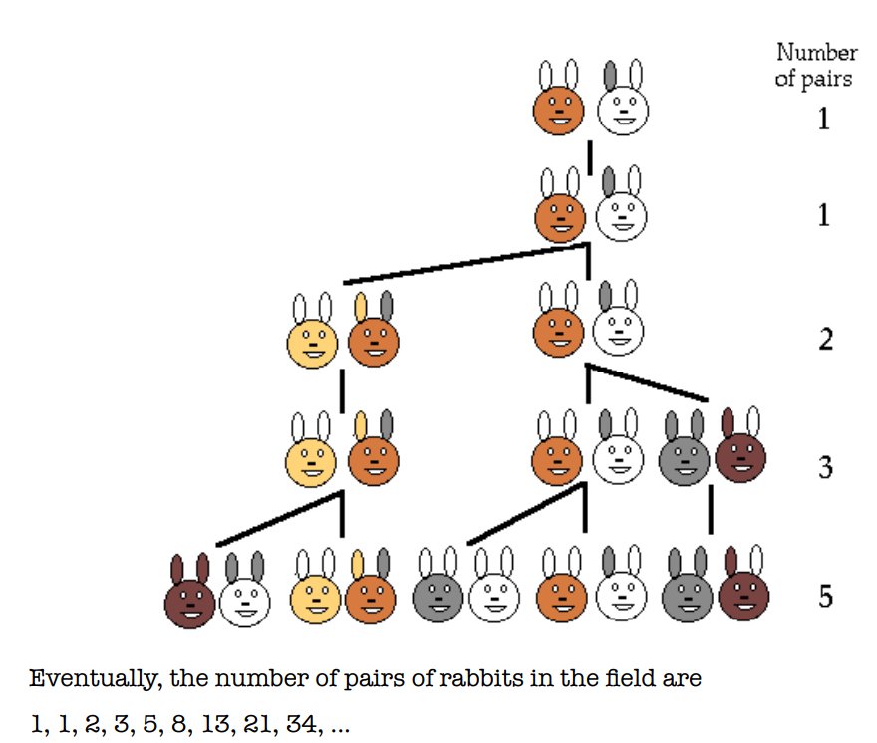
Fibonacci Series pattern (n-1)+(n-2)

Slide 4
Asymptotic Notations
It’s a mathematical way to represents Time complexity of an algorithm.
There are Three Well known Time complexity Notations:
Big Oh (O) (Used for Worst Case) Shows Upper Bound
Big Omega (Ω) (Used for Best Case) Shows Lower Bound
Theta (θ) (Used for Average Case) Shows Exact Time
Usually we represents the algorithmic time in Big O or worst case.

Slide 5
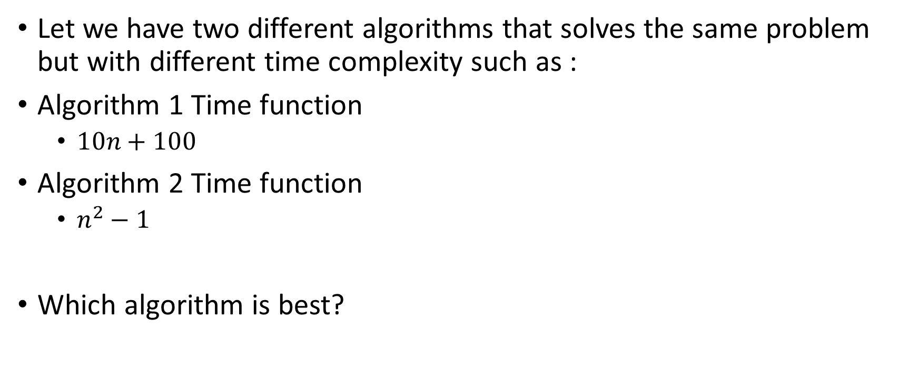
Example
Let we have two different algorithms that solves the same problem but with different time complexity such as :
Algorithm 1 Time function
$10n+100$
Algorithm 2 Time function
$n^{2}−1$
Which algorithm is best?

Slide 6
N=14

Slide 7
N=20

Slide 8
Big O Order Notation
There may be a situation, e.g.
g(n)
f(n)
T_{t}
1
n₀
n
f(n) <= g(n) for all n >= n₀ Or
f(n) <= cg(n) for all n >= n₀ and c = 1
g(n) is an asymptotic upper bound on f(n).
f(n) = O(g(n)) iff there exist two positive constants c and n₀ such that
f(n) <= cg(n) for all n >= n₀

Slide 9
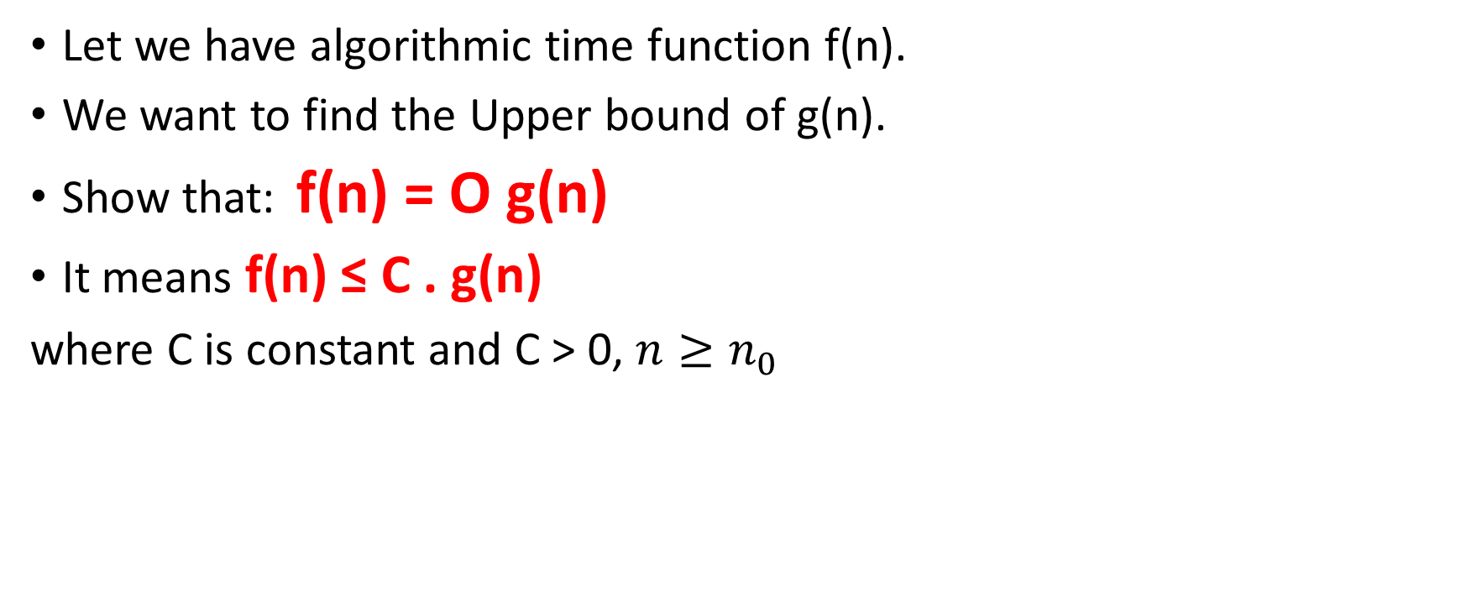
Big O
g(n)
f(n)
T_{t}
Let we have algorithmic time function f(n).
We want to find the Upper bound of g(n).
Show that: f(n) = O g(n)
It means f(n) ≤ C . g(n)
where C is constant and C > 0, $n≥n_{0}$
1
n₀
n

Slide 10
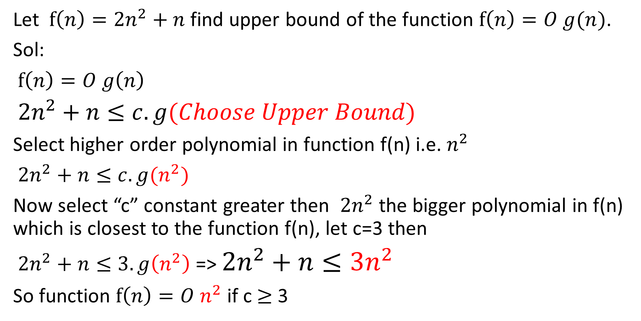
Big O Example
Let $f\left(n\right)={2n}^{2}+n$ find upper bound of the function $f\left(n\right)=O g(n)$.
Sol:
$f\left(n\right)=O g\left(n\right)$
${2n}^{2}+n≤c. g(Choose Upper Bound)$
Select higher order polynomial in function f(n) i.e. $n^{2}$
${2n}^{2}+n≤c. g(n^{2})$
Now select “c” constant greater then ${2n}^{2}$ the bigger polynomial in f(n) which is closest to the function f(n), let c=3 then
${2n}^{2}+n≤3. g\left(n^{2}\right)$ => ${2n}^{2}+n≤3n^{2}$
So function $f\left(n\right)=O n^{2}$ if c $≥$3

Slide 11

$${2n}^{2}+n Versus 3n^{2}$$

Slide 12
Big Ω Order Notation
Asymptotic Lower Bound: f(n) = Ω(g(n)),
iff there exit positive constants c and n₀ such that
f(n) >= cg(n) for all n >= n₀
f(n)
g(n)
n₀
n

Slide 13

Big Ω
f(n)
g(n)
Let we have algorithmic time function f(n).
We want to find the Lower bound of g(n).
Show that: f(n) = Ω g(n)
It means f(n) ≥ C . g(n)
where C is constant and C > 0, $n≤n_{0}$
n₀
n

Slide 14
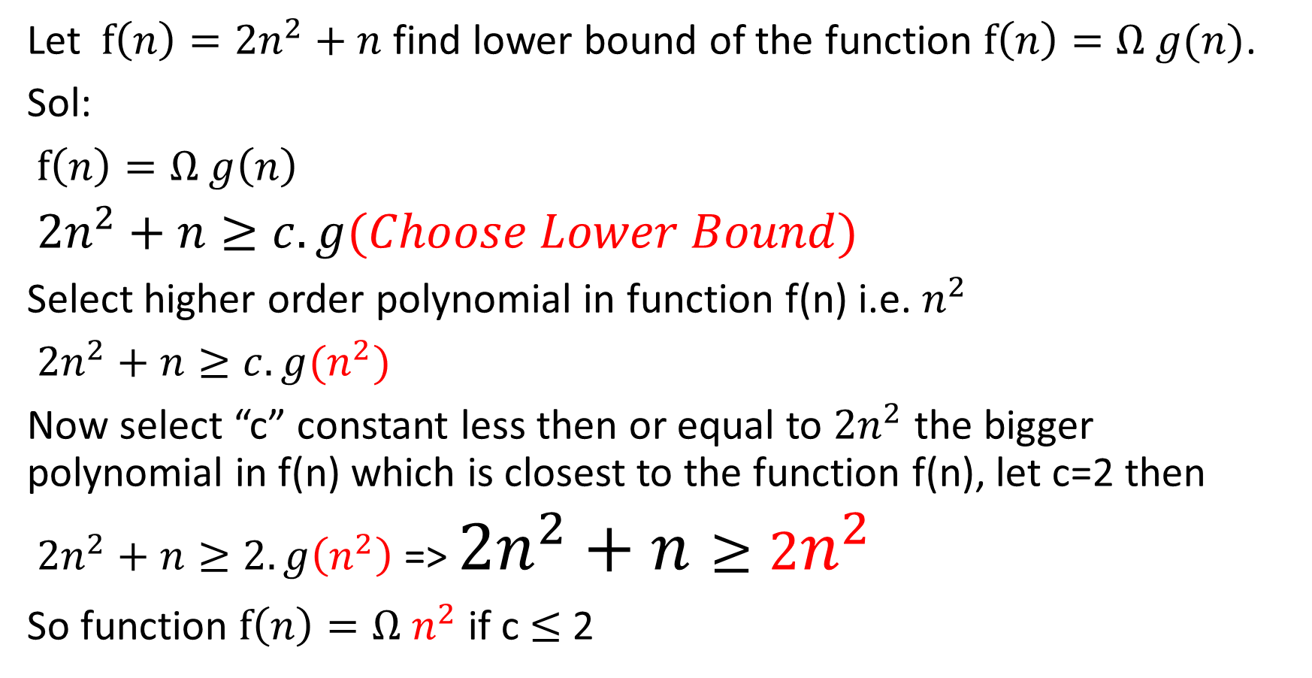
Big Ω Example
Let $f\left(n\right)={2n}^{2}+n$ find lower bound of the function $f\left(n\right)=Ω g(n)$.
Sol:
$f\left(n\right)=Ω g\left(n\right)$
${2n}^{2}+n≥c. g(Choose Lower Bound)$
Select higher order polynomial in function f(n) i.e. $n^{2}$
${2n}^{2}+n≥c. g(n^{2})$
Now select “c” constant less then or equal to ${2n}^{2}$ the bigger polynomial in f(n) which is closest to the function f(n), let c=2 then
${2n}^{2}+n≥2. g\left(n^{2}\right)$ => ${2n}^{2}+n≥2n^{2}$
So function $f\left(n\right)=Ω n^{2}$ if c $≤$2

Slide 15

$${2n}^{2}+n Versus 2n^{2}$$

Slide 16
Theta (θ) Order Notation
Asymptotically Tight Bound: f(n) = θ(g(n)),
iff there exit positive constants c₁ and c₂ and n₀ such that
c₁ g(n) <= f(n) <= c₂g(n) for all n >= n₀
c₂g(n)
f(n)
c₁g(n)
n₀
n
This means that the best and worst case requires the same amount of time to within a constant factor.

Slide 17
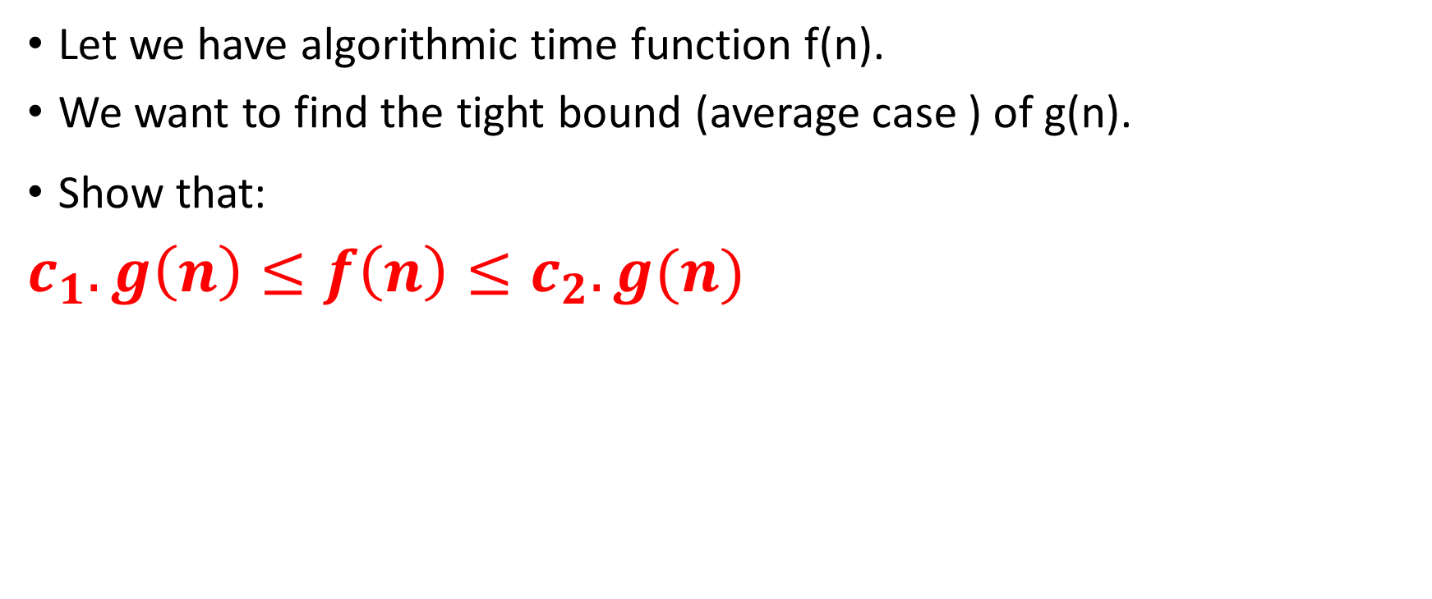
Theta (θ)
c₂g(n)
f(n)
c₁g(n)
Let we have algorithmic time function f(n).
We want to find the tight bound (average case ) of g(n).
Show that:
$c_{1}.g\left(n\right)≤f\left(n\right)≤c_{2}.g(n)$
n
n₀

Slide 18
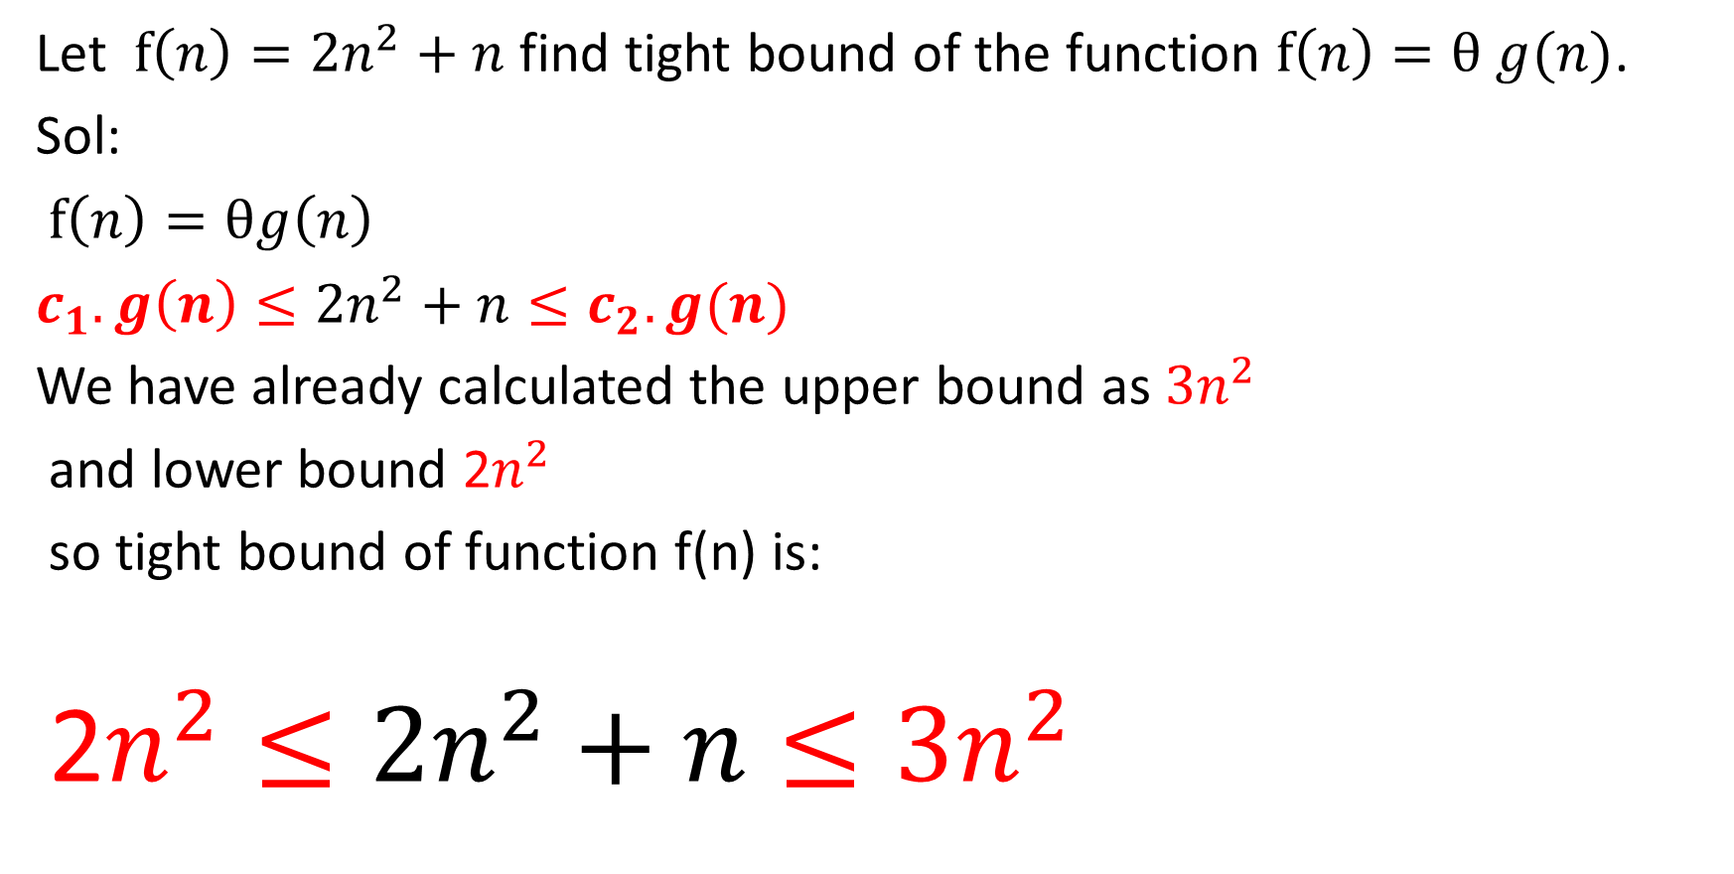
Theta (θ) Example
Let $f\left(n\right)={2n}^{2}+n$ find tight bound of the function $f\left(n\right)=θ g(n)$.
Sol:
$f\left(n\right)=θg\left(n\right)$
$c_{1}.g\left(n\right)≤{2n}^{2}+n≤c_{2}.g(n)$
We have already calculated the upper bound as $3n^{2}$
and lower bound 2$n^{2}$
so tight bound of function f(n) is:
$\text{2}n^{2}≤{2n}^{2}+n≤3n^{2}$

Slide 19

$$\text{2}n^{2}≤{2n}^{2}+n≤3n^{2}$$

Slide 20
Order Notation

Slide 21
Order Notation

Slide 22
Assignment
Exercise 3 Page 216
Questions: 1, 2, 3, 5, 6, 15, 25 (part A only)
Deadline Next Week.

